Slide 1

WEB TECHNOLIGUES
COURSE WORK
International Information Technologies University
Done By :Myrzan Bekzat 26481
Group: Csse 1803

Slide 2
CONTENT
1. Content
2. Short Description
3. Relevance
4. Features
5. Conclusion
6. References

Slide 3
SHORT DESCRIPTION
This site created for Qazaqstan premier league(football/soccer) and have several pages like home page, news page, teams, about and contacts page
Design and functionality of project on average level and can be changed for further production

Slide 4

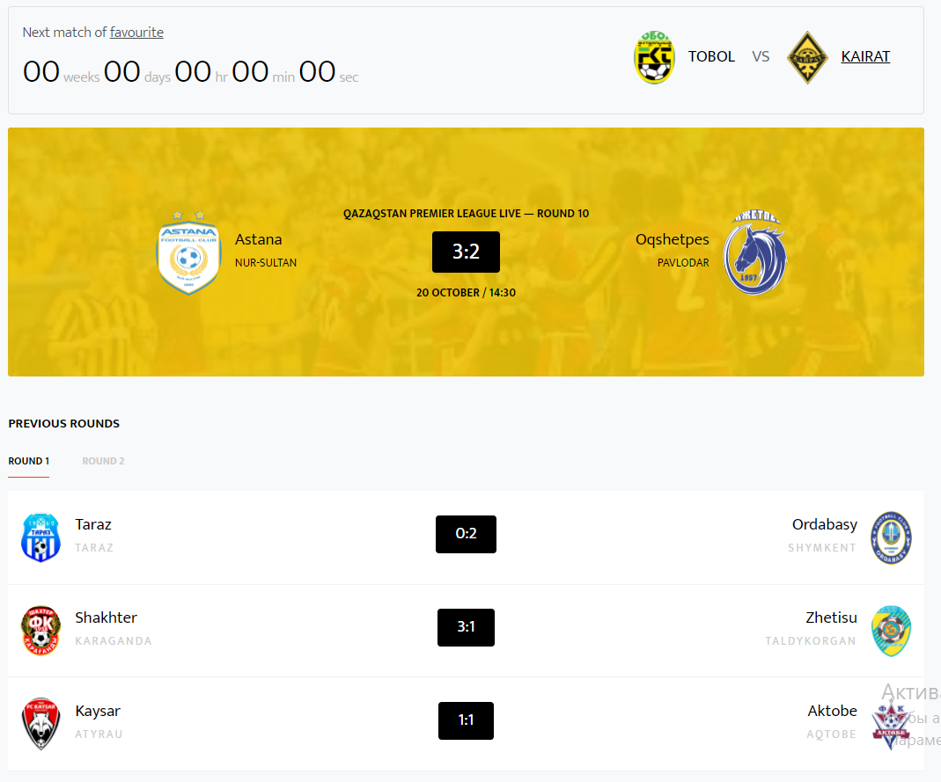
RELEVANCE
Have table with played matches/ previous rounds
Have several pages for
easy viewing

Slide 5
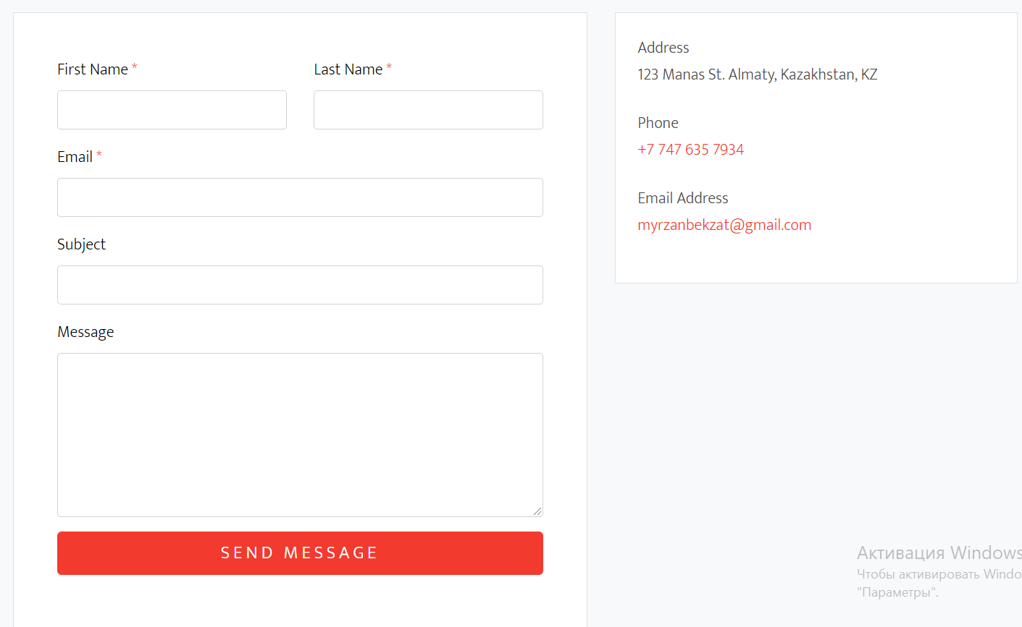
RELEVANCE
Block with contact form and address

Slide 6
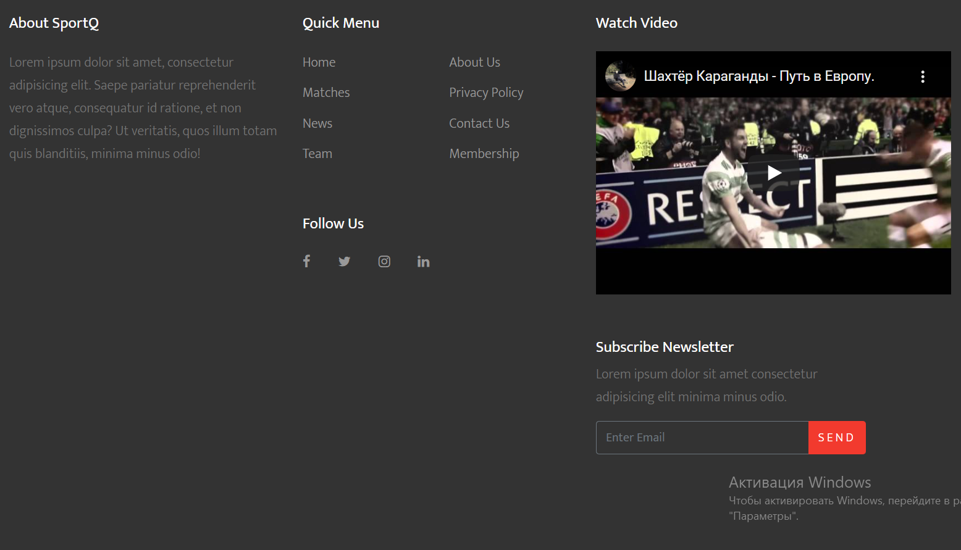
FEATURE
Have footer with links/blog/social links

Slide 7
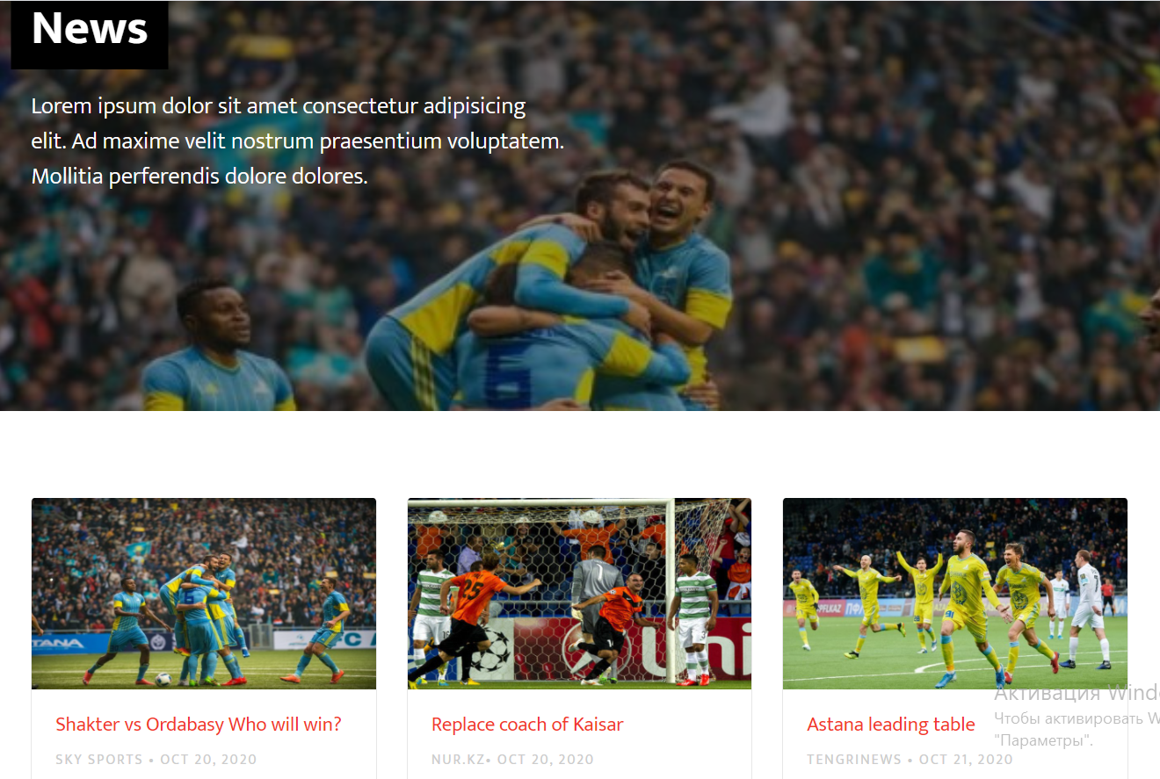
FEATURE
Have page with news in QPL

Slide 8
REFERENCES
1. https://www.tutorialspoint.com/php/php_introduction.htm
2. https://www.w3schools.com/php/DEFAULT.asp
3. https://www.tutorialrepublic.com/php-tutorial/
4. https://www.php.net/manual/ru/tutorial.php
5. https://www.phptpoint.com/php-tutorial/
6. https://getbootstrap.com/docs/4.0/getting-started/introduction/
7.

